Slide 1
West Lakes Conservancy District
Where We Are and What’s Next
Notes:
Thanks everyone for the support you've given so far. We're getting closer, but still have some hurdles ahead

Slide 2
Where We Are Today
Attorney Representation: Colby Barkes
Passed Some Major Hurdles
  Met the Petition Requirements & Filed with the Courts
  Initial Hearing – February 2026
    Judge approved and moving forward
  Awaiting Natural Resource Commission (NRC) Hearing Date
    Hearing scheduled but NRC postponed, awaiting reschedule date
Notes:
- Thank you to everyone who signed, to all who helped get signatures
- Initial Hearing - there was a vocal minority in attendance, they spoke to voice some of their concerns. The judge listened but ultimately it was decided in our favor
- Our attorney is in communication with the NRC, staying on top of getting the hearing rescheduled

Slide 3
Natural Resource Commission (NRC) Required Purposes
Kristi Johnson, Watershed Stewardship Manager, Indiana Dept of Natural Resources, will review the following as part of the hearing process:
  1. Is the Conservancy necessary?
  2. Does the Conservancy hold promise of economic/engineering feasibility?
  3. Does the Conservancy offer benefits in excess of costs?
  4. Does the Conservancy cover and serve the proper area?
  5. Could the Conservancy be established in a manner compatible with established conservancy district, flood control projects, reservoirs, lakes, drains, levees, and other water management or water supply projects?
Notes:
Allow some time for this to be read over and then say:
- I'll go into detail with each of these required purposes in the following slides

Slide 4
1. Is the Conservancy Necessary?
West Lakes Association (WLA) is not a sustainable solution
  Minimal budget and dwindling volunteer resources
Logjam Removal – Primarily volunteers with permission from landowners along the river. Because we have explored the establishment of a conservancy, we have been told WE WILL NOT BE ALLOWED TO WORK ON THEIR PORTIONS OF THE RIVER. At this point a conservancy is our only solution.
We have explored other solutions
  Joining a possible St Joe River Basin Watershed Development Commission
  North Branch of the Elkhart River (NBER) as a Natural Drain
The flooding in this area is well known
  Silver Jackets Report of 2010. Many recommendations but no funding
  NBER study of 2020. Recommendations but no funding
Notes:
What is the name of the St Joe River Basin thing???

Slide 5
2. Does the Conservancy Hold Promise of Economic/ Engineering Feasibility?
Projects taken from DNR/Corps of Engineers in Silver Jackets and NBER studies
Cost of Conservancy District vs extreme costs of past floods and estimates of future floods
Average cost of only ~$116 per freeholder based on 2025 assessed values
Ability to secure additional grants
Goals and projects of the WLCD have been supported by the DNR
Multiple LARE grants
This is an attempt to stand on our own and directly raise funds that are sorely needed
Notes:
Need Average cost information

Slide 6
3. Does the Conservancy Offer Benefits in Excess of Costs?
Adequate but not excessive budget created to accomplish needed tasks but no allowance for mission creep
  There is no budget, plans, desire or allowance for campsites, hiking trails, and other property rights infringing endeavors. These are not planned and are not even economically feasible
Careful to not overreach
Property values with and without flood events
Currently using volunteers. There have been some very close calls that could have resulted in serious injury or worse. This is not sustainable and poses a significant risk for workers as well as liability for property owners and WLA
Notes:
Add funded into pertetuity as a benefit

Slide 7
4. Does the Conservancy Cover and Serve the Proper Area?
¼ mile around lakes. 1st and 2nd row homes enjoy the lakes. Runoff occurs from all within boundaries
Flood Hazard map shows impact of high water on proposed borders
Properties bordering river. This addresses:
  The area of the river where most of the tree removal and weed treatment is necessary
  The flood hazard risk tends to be localized to the river border
  In determining the boundaries, we considered the property rights of the freeholders – did not want to overtax in the interest of fairness – only properties immediately adjacent to the river, and extending no more than ¼ mile into the property
Only about 26% participation in WLA while the entirety reaps benefits
WLA through dues, donations, and volunteers has removed hundreds of logjams in the past 11 years. Every one of these obstructions belongs to the property owners downstream of Dukes Bridge.

Slide 8
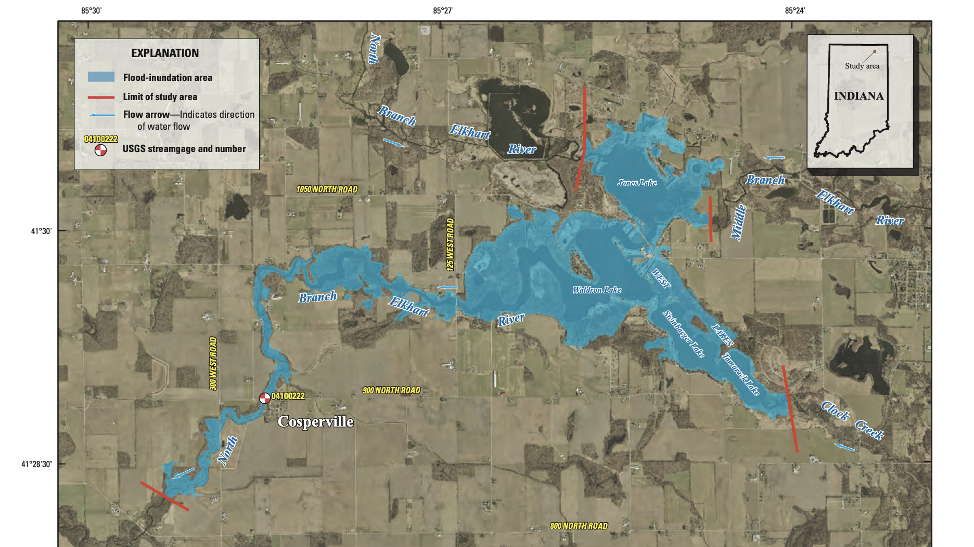

Slide 9
5. Could the Conservancy be established and operated in a manner compatible with established conservancy district, flood control projects, reservoirs, lakes, drains, levees, and other water management or water supply projects?
Although there are many entities involved in the regulations pertaining to the boundary areas, none are responsible for taking action
  DNR has assigned management of the Stop Logs to the WLA
  The Silver Jackets Report outlines many steps that would help mitigate flooding, but no actionable items by any existing entity
  Noble County is willing to partner with the WLCD to address the excessive sediment issues, but is not addressing it independent of the WLCD
  IDNR, IDEM, Engineers, US Fish and Wildlife, EPA, Army Corps of Engineers, FEMA and others – all provide governance, but NO ACTION to address our issues

Slide 10
West Lakes Conservancy District Project List
1. Flood prevention and control
2. Prevention of loss of topsoil from injurious water erosion
3. Developing forests, wildlife areas, parks and recreational facilities where feasible in connection with beneficial water management
4. Operation, maintenance, and improvement of any work of improvement for water based recreational purposes, or other work of improvement that could have been built for any other purpose

Slide 11
Purpose #1 – Flood Prevention and Control
Anchor Propane Tanks Located Below the Base Flood Elevation (BFE).
This is a life-safety concern. The floating and release of hundreds of gallons of propane per tank could be catastrophic.
Working with the County to modify and enforce code could easily prevent this hazard
Taken from Silver Jacket Report (SJR)
Health and Safety concern. Flood water infiltration into wells poses health risk
Elevate Water Well Heads to Above BFE
Work with County to strengthen and enforce code on new builds
Taken from SJR
Notes:
- add new construction to code...

Slide 12
Purpose #1 , Continued– Flood Prevention and Control
In-Channel Aquatic Vegetation Control
Treatment of aquatic vegetation within “transition area” to enable consistent water flow
Maintain Existing Streams Using Best Practice
This is selective targeting of problematic logjams removal and has been effective at keeping natural state of drainage
Previously supported with DNR LARE grants
Taken from SJR and NBER Study
Taken from SJR
Previously supported with DNR LARE grants
To be done within the first 3½ feet of fall in river
Notes:
Add distance in ( )

Slide 13
Purpose #1 , Continued– Flood Prevention and Control
Strengthen Relationship With Regional Leadership Regarding Floodplain Management Practices
Work cooperatively with local drainage board
Address Flood Prone Access Roads.
Coordinate with Noble County Highway Dept to prioritize elevation of roads to allow for emergency and routine traffic
Coordinate and strengthen relationship with local flood plain manager
Taken from SJR
Notes:
drainage board/surveyor

Slide 14
Purpose #1 , Continued– Flood Prevention and Control
Promote Participation in the National Flood Insurance Program (NFIP)
Work with the NFIP representatives to educate freeholders in the area (both within and outside the Conservancy boundaries)
Recommended by SJR
Recommended by NBER study

Slide 15
Purpose #2 Prevention of Loss of Topsoil From Injurious Water Erosion
Limit Fertilizer, Nutrient, and Sediment Loading
Work cooperatively with Noble County officials to pursue 2-stage ditches/sediment pits upstream of lakes
Protect Existing and Historical Natural Flood Storage Areas
Work cooperatively with county and land trusts to protect storage areas
Recommended by SJR
Recommended by NBER study
Recommended by SJR
Recommended by NBER study

Slide 16
Purpose #3 Developing forests, wildlife areas, parks and recreational facilities where feasible in connection with beneficial water management
Water Quality Testing
Partner with water quality experts to perform regular testing
Dredging
Reforestation
Perform dredging to maintain navigability in the channels between the lakes
Partner with Acres Land Trust to reforest denuded areas
Notes:
Work on adding details to this slide
Partner with water quality experts to test f
Implement water quality testing stations
Dredging - maintain channels between lakes to ensure navigabilty
Affected by deforestation

Slide 17
Purpose #4 Operation, maintenance, and improvement of any work of improvement for water based recreational purposes, or other work of improvement that could have been built for any other purpose
Stop Log Operation
Use contractors for installation and removal of stop logs at the lake level control structure
- Installation and removal of stop logs is mandated by DNR per agreement with WLA

Slide 18
Things the Conservancy Is NOT
The Conservancy is NOT pursuing eminent domain.
  There are NO plans to pursue eminent domain - The Conservancy does not have a budget that supports eminent domain and none of the goals of the Conservancy necessitate it

Slide 19
Things the Conservancy Is NOT
The Conservancy cannot independently raise taxes
  The tax rate is capped at .0005 of assessed property values. The rate will not increase. Your tax amount will increase or decrease only as your property values change

Slide 20
Things the Conservancy Is NOT
The Conservancy does not provide random people with access to private property
  The Conservancy only grants access to personal property under limited conditions
  It does NOT allow for public use of private property!

Slide 21
West Lakes Conservancy District
Questions?

